Slide 1
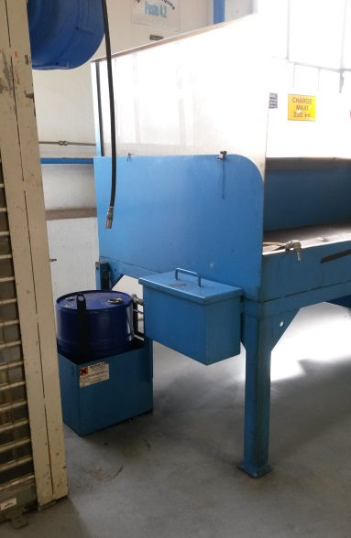
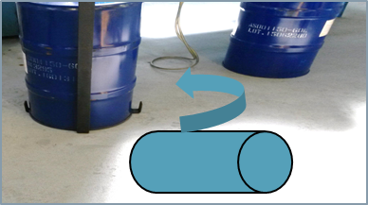
HS&E INCIDENT BULLETIN |  | 1st half year 2017
Le Havre, France | Type of incident (Back Strain – Manual Material Handling)
Summary:
Two operators were handling a 60 L (15.9 gal) solvent drum in order to put it in place on a lifting support. The drum was initially lying horizontally on a pallet. They manually lifted it 10 cm (4 in) above the ground to place it on the lifting support. During this manual handling operation, one of the operators felt a backache. He immediately went to the infirmary where he received first aid. He visited his personal doctor after work. He was diagnosed with a back strain and has taken time off work to recover.
Root Causes: | Actions Taken Thus Far: Next Steps
Lack of situational awareness. No Stop Work was completed even though the drum is heavier than 15 kg (33 lb) (manual handling is not allowed per local policy). Proper lifting tool dedicated for this operation was not known by the operators. Lifting support design was not appropriate with a 10 cm (4 in) step. | Awareness/review was done for all applicable operators. Reviewed all similar activities through all workshops. Reviewed risk assessment (HIRA). No manual handling for this operation and only use lifting accessories. Change lifting accessories for this operation.

